Slide 1
Primary and Secondary Sources
AN OVERVIEW OF WHAT THEY ARE & HOW TO DETERMINE THEIR CREDIBILITY

Slide 2
Primary sources are historical items or accounts from a particular time period in the past. These sources are first-hand. This means that they were the very objects used in the past or are the words and documents from people directly involved in the event under discussion.
Examples include:
autobiographies | letters | government records
photographs | diaries | artifacts

Slide 3
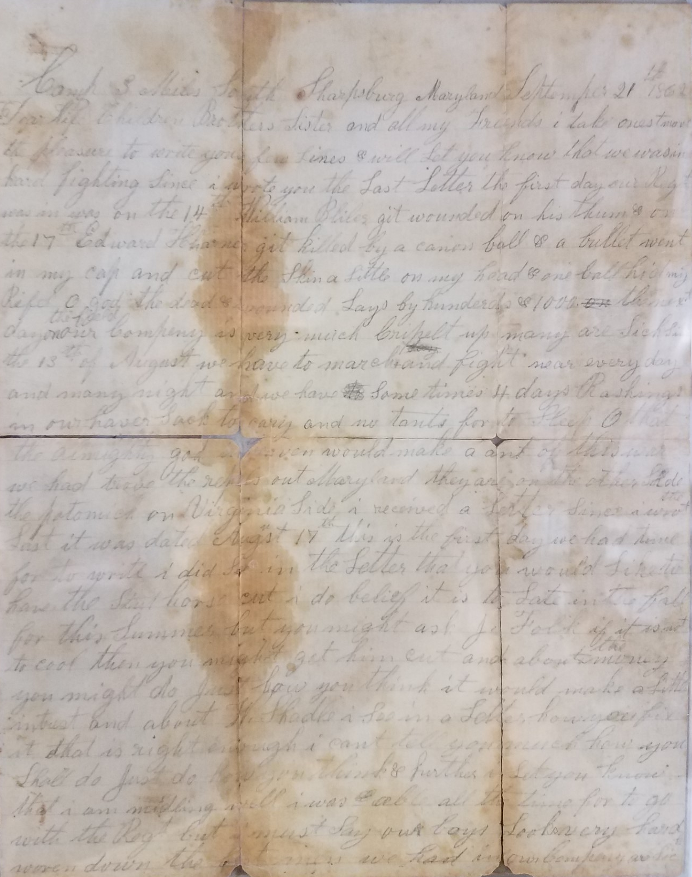

Slide 4
Secondary sources are sources of information that were created after an event took place or after a person lived. These sources are not first-hand accounts.
Examples include:
biographies | textbooks | encyclopedias
essays | articles (written after the event)

Slide 5
CAN IT BE BOTH?
Some types of sources can be interpreted as both a primary and secondary source.
Example: A biography about Thomas Jefferson could be written by someone who knew Jefferson personally (primary source), or it could be written by someone who did not know him personally (secondary source).

Slide 6
WHICH SOURCE IS BETTER?
What are the pros and cons of primary sources?
What are the pros and cons of secondary sources?

Slide 7
EVALUATING SOURCES
To determine whether a source is credible, ask yourself the following questions:
Are there citations or references?
Is this source from a trusted website or institution?
Is this source using clickbait or excessive advertising?
Is this source relatively recent?
Is this source biased?

Slide 8
Bias
A bias is a tendency to prefer one thing, idea, or person over another.
Often times bias has a negative connotation, but it doesn’t necessarily have to be negative. Everyone has biases!
Our biases influence how we see the world.

